Slide 1
UC DAVIS
Data Analytics Bootcamp
February 24, 2020
Data Analysis of IMDB movies released between 2000 and 2019

Slide 2







Slide 3
Introduction:
The Internet Movie Database (IMDb) is a website that serves as an online database of world cinema containing a large number of public data on films such as the title of the film, the year of release of the film, the genre of the film, the audience, budget, revenue, the rating of critics, the duration of the film, the summary of the film, actors, directors and much more.

Slide 4

Scope & Purpose:
Analyze the data available on IMDB for movies released between 2000 and 2019.
Questions that our analysis will answer:
Which genres have the most movies?
Which genres have high production budgets?
Which genres are more profitable?

Slide 5

Data Exploration:
Data Exploration:
After hunting for data on the internet, we used the IMDB database and an API key to extract raw data. This database contains a large volume of unstructured data which need to be cleaned and structured for use in research and education.

Slide 6
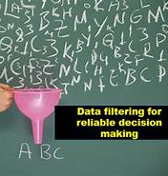
Data cleanup:
Inventorying data
Data selection
Movie title
Genre
Year
Budget
Revenue
IMDB’s code is HTML, CSS & Javascript, after parsing and recovering data, we developed a csv file and JSON to conduct analysis on.
Used python script to scrape data
Updated python script to not take into account movies with missing data

Slide 7

Analysis process: Used pandas library to have an overview of the datasets. The following are category types for our statistical data analysis and modeling:
Genre
Budget
Revenue
Rating

Slide 8
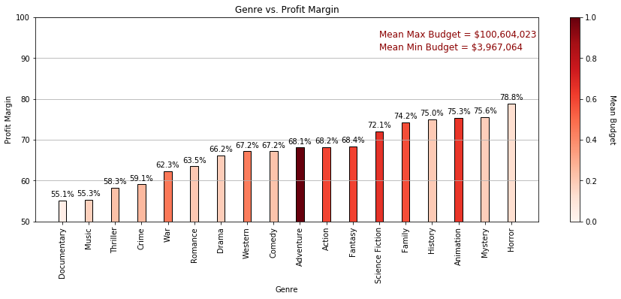
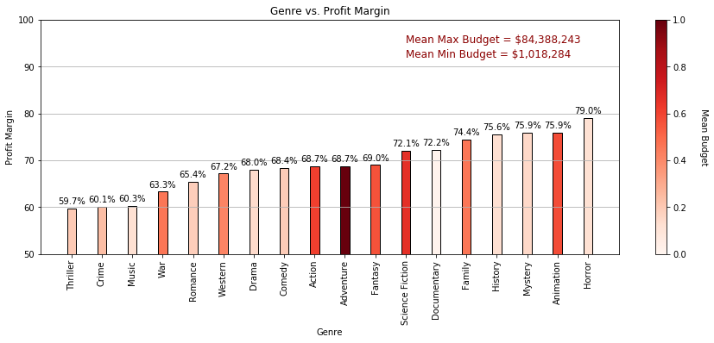
Genre

Slide 9
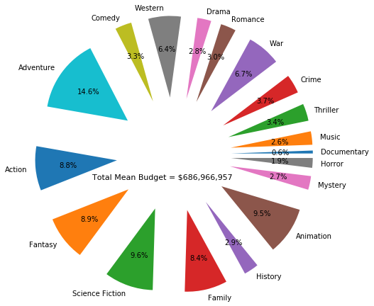
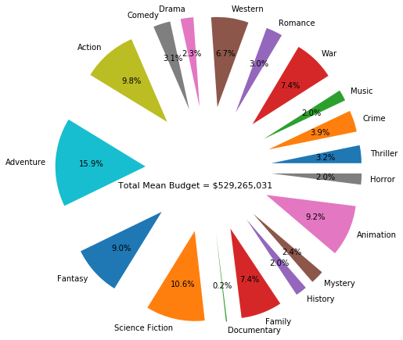
Budget:

Slide 10
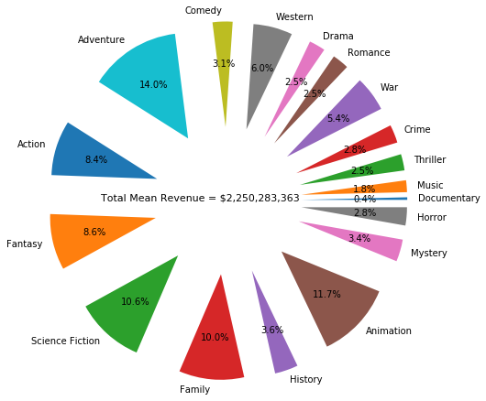
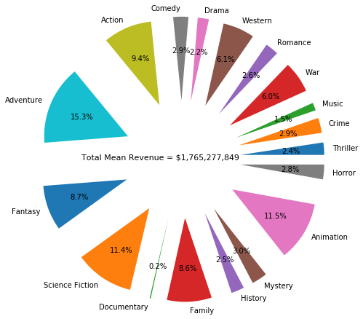
Insert a snapshot of the revenue analysis
Revenue:

Slide 11
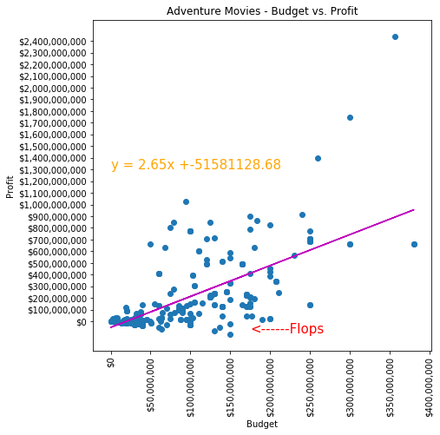
Budget vs. Profit:

Slide 12

Rating:

Slide 13
Our Findings:

